Slide 1
A Grain of Wheat: Ngũgĩ wa Thiong'o
Reggam Manal
Hemida Nour El Imene
Souadkia Rayyene

Slide 2
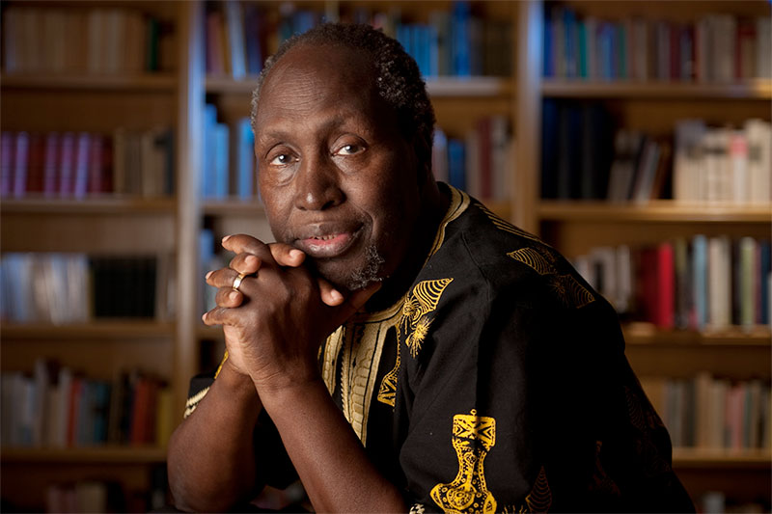
Biography of Ngũgĩ Wa Thiong'o
Ngugi wa Thiong'o , original name James Thiong'o Ngugi,(born in 1938,Limuru ,Kenya),Kenyan writer who was considered East Africa's leading Novelist. He is Gikuyu and grew up speaking the Gikuyu language as well as English. He went to Uganda for college and graduated from Uganda's Makerere University in 1963-the same year Kenya won it's Independence from England.
*
Designed by PoweredTemplate.com
2

Slide 3
IN 1964 ,he published his first novel ,Weep Not ,Child, written in English. In 1965 he published his second novel, The River Between. His third novel ,A Grain of wheat, came out in 1967;around this time ,he embraced Marxism, began critiquing English as a second language That colonizers forced on Kenyans, and changed his name from James Ngugi to Ngugi wa Thiong’o.
He published his fourth and final English-language novel ,petals of blood ,in1977;due to the novel's trenchant critique of Kenyan politics ,as well as the critique forwarded in his 1977 play I Will Marry When I Want, the Kenyan government arrested him, and he spent a year in prison. After his 1978 release, He and his family fled Kenya .He spent time teaching at various international universities. He also wrote plays and numerous essays on literature, culture, and politics.

Slide 4
Language and Style:
Ngugi Wa thiong ‘o‘s a grain of wheat is a Kenyan novel written in English .
Although Ngugi used the English language; he uses it to fight the colonizer with his own language also to celebrate his African culture and traditions through folk songs, proverbs and metaphor.
Ngugi asserts that English language unable to describe exactly the African culture since they are totally the opposite,the African and British culture .
He used also the English language to share the story of resistance, fight, sacrifice for the country worldwide, in addition to reveal the crimes of the British colonization in Kenya.

Slide 5
Ngugi used the character of Karanja to display the language barriers and inability to communicate with the Foreigner, since he always uses non-verbal way to express himself.
Ngugi incorporates culture artifacts like songs by that he shows tribal pride and independence, also he uses English in these folk songs to recall the attention to the operation of the people at the hands of English colonizer
He adopted multiple narration techniques
He applied anonymous narration techniques
the narration is everywhere but it’s not a character, the story told by the third person.
Collective narrative methods, each character participate in narrating.

Slide 6
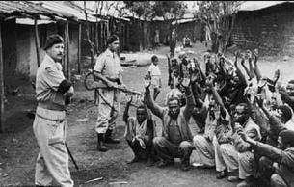
Context
The story is set in the four days preceding Kenyan Independence in December 1963, and recalls events as far back as British settlement in Kenya in the first two decades of the twentieth century.
The Mau Mau Uprising began in 1952 as a coalition of the Gikuyu, Meru, and Embu people of Kenya against British colonial forces. Although their primary leader was captured in 1956, the Mau Mau continued to wage war against the British until Independence.

Slide 7
The characters:
KIHIKA:
Kihika is the great hero of the Gikuyu and a leader of the Mau Mau Freedom Fighters.
Kihika is the brother of Mumbi and kariuki
He consider himself as a noble who sacrifice himself for the sake of others , especially in times of great historical struggle , even recognizing himself as a possible Christ figure in his leadership and sacrifice .
Kihika stands opposite John Thompson, and he also betrayed by Mugo, , and executed for his leadership of the Freedom Fighters and his assassination to Thomas Robson.
In his death, Kihika becomes a symbol of the resistance and hope for his people, as in the title “grain of wheat” referred that his death brings new life into the world.
*
7

Slide 8
John Thompson:
- John is a British administrator and Margery’s husband
He viewed that the colonialism as great moral cause , since it modernize and purify people from their savage , primitive world , so he decided to move with his wife to east Africa to participate in colonization,
He was ruthless overseer, even causing the deaths of eleven prisoners in a detention camp that he oversees, for him there is no moral about colonialism.
John represented an image of power but is actually weak. After the Kenyans win their independence, John had been defeated and he becomes disillusioned with his life, colonialism’s great purpose, and even his wife, then they left Kenya for ever.

Slide 9
Warui :
Warui is a notable village elder who tries to convince Mugo to lead the indepandance celebration and become a Chief in the village.
Warui is an old man and has been involved in the Movement and fought for Kenya for the rest of his life.
As an old man he was teaching his stories of oppression to young Kihika
He was proud of Kihika and Mugo as great African leaders until Mogu's confession, warui was disappointed by the loss of a hero.

Slide 10
KARANJA:
Karanja is a villager of Thabai and works for John Thompson in Githima.
He was friend of Gikonyo and Kihika and is in love with Mumbi , but she rejects him .
When his friends are swearing the oath and joining the freedom fighters movement , or arrested and taken to detention , Karanja started to work with the Whiteman , so he betrayed his country to save himself
He was obsessed with the power of the Whiteman’s technology

Slide 11
Mugo
A handsome, introverted, mysterious man who lives in the village and spent time in the detainment camps. Mugo is viewed by everyone as a hero because he worked with Kihika and never cracked under pressure. He secretly was the one who betrayed Kihika, which he eventually admits after hearing Mumbi confide in him regarding her own life story; he announces he was guilty at the Uhuru celebration, which he originally thought he might attend in a capacity as savior of the people.

Slide 12
Gikonyo
is Mumbi’s Husband. Gikonyo spends his early years as a poor carpenter supporting himself and his mother, who were abandoned by his father. Although he is shy, Gikonyo falls in love with Mumbi and for a few months he is deliriously happy. However, this comes to an end when he is arrested and taken to detention. He spends years in a detention camp dreaming of returning to her. He is bitter and disillusioned when he comes back to find his wife had born a child from another man. He throws himself into work and becomes wealthy; he is a model for people in the village.
Mumbi
the wife of Gikonyo and sister of Kihika. As a woman, Mumbi is also the strongest main character in the story, demonstrating the power of women and their ability to affect events and succeed where men have failed. Although Gikonyo was imprisoned she resists Karanja’s advances for the six years , she is so dispirited and weakened by the end that she betrayed her husband , eventually giving birth to Karanja’s child.

Slide 13
Summary :
Mugo has only had one interaction with the Movement, at a meeting where he heard Kihika speak as a young man.
Representatives from the Party and prominent members of the village ask Mugo to lead their independence celebration and become a village chief, but Mugo refuses, since he betrayed Kihika and no one in the village knows his crime.
Karanja works for the British colonizers at a nearby agricultural research station in Githima, but he is afraid of white people and cannot find the courage to ask John Thompson or Margery about their plans to leave Kenya.

Slide 14
Mugo is seen as a hero by the people of his village, but Gikonyo, who had spent years in British detention camps on suspicion of being a Freedom Fighter, confesses a great burden he has carried for years. The guilt he feels for confessing haunts him still, many years later.
Mugo decides to bury his past and accept the role asked of him, envisioning himself as a saviour, leading his people to freedom. Mumbi confides in Mugo about the forced labour the village endured after most of the men were arrested and put in detention camps.
Karanja became the reigning chief of Thabai and a ruthless governor. He professed his love for Mumbi several times, but she always refused to be with him.

Slide 15
Karanja is persuaded to attend the upcoming independence celebration, and John and Margery Thompson say goodbye to their British co-workers.
Mugo walks through the village, which now feels less disconnected from him than it once did, and meets Warui and Gikonyo. He tells them he is unwell, but the people of Thabai view him as even more humble and virtuous, and his renown quickly spreads, making him a nearly mythical figure overnight.
Mumbi is horrified by Mugo's story, but turns to pity when she sees the pain in Mugo's eyes. She leaves, and Mugo is mentally tormented throughout the night.

Slide 16
The next morning, at the ceremony of remembrance, Gikonyo and Karanja race against each other, but Gikonyo breaks his arm and is sent to the hospital. Karanja remains, but Mugo arrives and confesses that he has betrayed Kihika.
General R., Lt. Koina, and Wambui arrive at Mugo's hut at night to hold a trial in the forest and execute him. Karanja leaves in shame.

Slide 17
However , his position gives him appearance of power though he is just a coward and afraid of the white people also his own countrymen.
He used his power to be close of Mumbai.
when John Thompson and company leave the country, Karanja’s power leaves with them , so he became hopeless and rejected by Mumbi and his community .

Slide 18
Symols in The Novel
IRION SNAKE (TRAIN):
Ngugi used the symbol of the iron snake to represent the evil of the colonialism and how people are worry and afraid of it.
CHAPTER 2 QUOTES: “suddenly saw a long line of other red strangers who carried not the Bible, but the sword. […] The iron snake […] was quickly wriggling towards Nairobi for a thorough exploitation of the hinterland “
The Oath:
It represents the promise which freedom fighters pledged to fight till death for Kenya’s independence
CHAPTER 7 QUOTES: “I die for you, you die for me “

Slide 19
The Christ:
The symbol of Jesus is mostly represents in the character Kihika, because he sacrifices himself for his beloved country, the same as what Jesus did for his community and people since he was nailed to the tree.
Mugo’s hut:
It represents the shelter and isolation, also its where mugo get lost with his ideas and self, hiding from others, facing his deep buried secrets.

Slide 20
Themes
Colonialism:
Kenya was colonized by the British in 1895 and was not independent until 1963.The novel introduced the influence of colonialism on Kenyan people and culture.Ngugi wanted to give a voice to the experiences and perspectives of Kenyan people.all of characters lives are affected by colonialism,whether they are in detention camps or the movement or losing their homes and land or trying to repair their fractured families.

Slide 21
Love:
We can find example of love marriage of Gikonyo and Mumbi in this novel. Also we can realizes that every person of this novel is in love with Uhuru, self-freedom and nativism. They want to fight for their native land and want to see their self-free from British Colonization
Unity:
Being unified help the Kenyans stand against the Europeans. The Mau Mau revolt was established to achieve one particular aim, “Fight for our land and Freedom”
Despite the death of Waiyanki and Kihika, the other forest fighters still maintained their stand. They continued fighting to the last : "United we stand, divided we fall.”

Slide 22
Betrayal, Guilt, and Redemption
Almost every character feels guilty about something in this novel, and those sources of guilt tend to derive from a betrayal of another character or of the Kenyan people. Mumbi has betrayed her husband, Karanja has betrayed his people when he worked for the British as a member of the homeguard during the Emergency, and Mugo has betrayed Kihika. These characters manifest their guilt differently, with both Mumbi and Mugo eventually taking the path toward redemption while Karanja can only choose that of exile. Mumbi and Mugo's redemption comes from open confession of their sin and a willingness to accept the consequences. Also Mugo's death offers redemption to the community as a whole.

Slide 23
Role Of Woman:
Ngugi Wa Thiongo’s presented the role of woman in several aspects. Woman took care of the family. Mumbi took care of Gikonyo’s mother and her (Mumbi) son in Gikonyo’s absence. Woman were perceived as a link between the people in the village and the freedom fighters in the forest. Wambui, on an occasion, took a gun to the forest fighter.

