Slide 1
University of 08 Mai 1945 – Guelma Faculty of Letters and Foreign Languages. Department of English. Presentation in C.W Literature about Contemporary Anglophone Canadian Literature .
● Bekhairia Bouchra
● Kennat Chanihez
● Sabeur Hadil
M2. Grp: 02 Dr.Bendjemil.K.

Slide 2
Components:
Introduction.
1- The definition of Canadian Literature.
2- The history of Canadian Literature.
3- Characteristics of Canadian Literature.
4- Major Writers and Novels of Canadian Literature.
5- The Themes of the Canadian Literature.

Slide 3
Introduction:
Writers have described Canada in many ways; for example, as a French or English colony, a “fifty-first state,” a Pacific Rim country, an Arctic giant, a friendly territory or an uninhabitable wilderness.

Slide 4
Canadian writers sometimes reinforced by writing romantic adventures of the frozen North, in which everything local was savage or hostile and “civilization” was imported. But over time, they sought to record local experience and to use literature to shape their own culture rather than to imitate or defer to the presumptions of another society.

Slide 5
Canadian culture continues to be shaped by a range of languages in use and by wide variations in geography, social experience, Indigenous cultures, immigration patterns and proximity to Europe, Asia and the USA, the “Canadian voice” is not uniform. Nevertheless, however much their aesthetic practices and political commitments may differ, Canadian writers bring many shared perspectives to their representations of nature, civility and human interaction, whether at home or abroad.

Slide 6
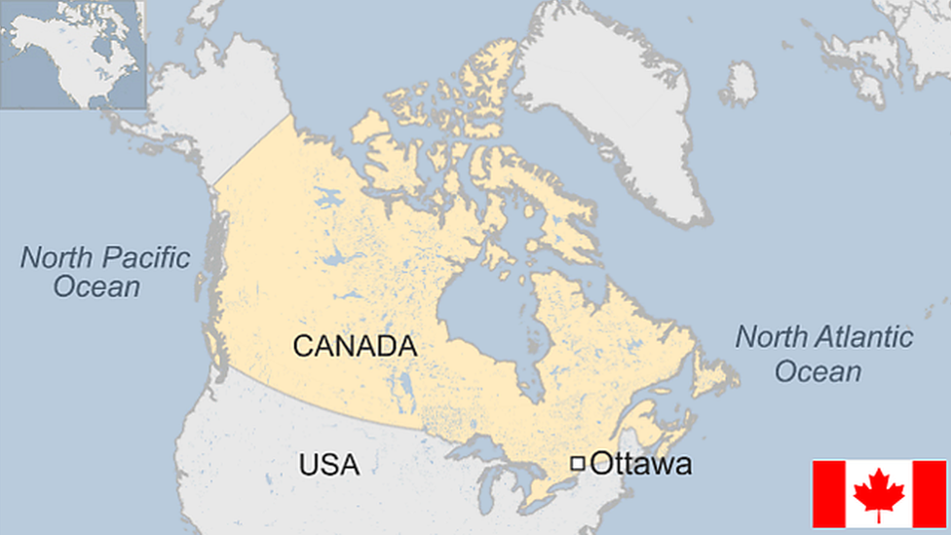

Slide 7
1- The Definition of Canadian Literature
Canadian literature is the literature of a multicultural nation, written in many languages ​​such as Canadian English, Canadian French, Indigenous languages.
Canadian literature, the body of written works produced by Canadians. Reflecting the country's dual origin and its official bilingualism, the literature of Canada can be split into two major divisions: English and French.

Slide 8
Charles G. D. Roberts, considered the father of Canadian literature, wrote descriptive verse about New Brunswick and Nova Scotia in such works as Orion and Other Poems (1880).
HOW THE ANGLOPHONE CANADIAN LIT BEGINS:
Anglo-Canadian literature begins with travel writings by two Englishmen and precisely with Account of a Journey from the Hudson Bay to the North-West by Samuel Hearne and with Voyages from Montreal through the Continent of North America by sir Alexander Mackenzie

Slide 9
What makes the canadian literature unique ?
Every region of Canada has a distinct identity, and, unlike almost every other national literature, Canadian literature has been heavily influenced by immigrant writers; some of Canada's most widely praised authors were not born in this country

Slide 10
2- History of Canadian Literature A. Colonial Literature In the early 17th century, Canadian literature began to come into existence in the form of exploration literature with Jacobean poetry in Newfoundland and with epistolary fiction of the English garrison community in Québec.

Slide 11
After the end of 1776, many Canadian writers began to produce political humorous writing in English Newspapers and literary magazines became a good source of publication for political commentary of conservative and reform-minded, and also for literary expression, which was used to be followed in 19th century generally in Romantic Sentimental and Orientalist fashions in Britain.

Slide 12
Nova Scotia emerged as a form of satire in that time. Novels, dramas and poetry all suffered a historical romance and Gothic paradigms. Susanna Moodie’s Settlement Narrative was one of many early autobiographies.

Slide 13
In travel writings, many short personal sketches of persons and places were included which formed the basis for much travel writings and also for the short fiction that emerged as a new genre during the 19th century.

Slide 14
The genre of folksongs and folktales survived, but Native oral literature received slight literary concentration until the later 19th century.

Slide 15
B. Early National Literature
From 1867 to 1914, Canadian literatures turned much towards confederation and during the five decades following, much attention turned to literary and political organization. Schools and universities were opened like several Carnegie Libraries.

Slide 16
Thoughtful discourses in the form of philosophical and science writings emerged on papers and because of the travel writings several other kinds of writings like impressionistic and reportorial writings also came on the literary platform of Canada.

Slide 17
In the end of 19h century, advocates of women’s suffrage and prohibition wrote stories and essays on issues of social transformation. In the early 20th century, many books like comic sketches of Stephen Leacock had dealt ironically with social platitudes.

Slide 18
Then, the Confederation Group of poetry produced significant writings in 19 century in which nature, winter, and the Canadian landscape were
deeply fascinating.

Slide 19
C. Interwar and Postwar
These two inter and post wars changed the cultural and social milieu of
Canada to a great extent. A new generation of literature emerged and
discarded the past theories in literature and new rewards were also
announced for literary accomplishments.

Slide 20
The fiction of 1920s kept on the convention of class distinction while in 1930s, anti war and class critique novels began to appear that focused on uprooted or marginalized individuals and pangs of non-English-speaking immigrant. They spoke more firmly and realistically for the cause of the common man.

Slide 21
Then, writers like John Glassco and Morley Callaghan appeared but could do nothing good to story writing. Young writers of this time were more inclined to the modernist tendencies of poets like T. S. Eliot, gave less value to ancient social ideas, and began writing dramas that satirized nationalist pageantry, published erotica and were greatly impressed by the group of seven painters.

Slide 22
The advent of Second World War offered a mixed literary culture of
propaganda, pacifist rhetoric, parodies of military ineptitude and a new
wave of progressivist writers, by turns humanist, anti-clerical, community-minded, and intellectually anarchist. Irving Layton, Earle Birney, Gabrielle Roy, P.K. Page and George Woodcock became significant names.

Slide 23
Literary periodicals and new technologies of communication and
entertainment emphasized the need of more locally grounded need of
language and from 1943, contributed much in broadcasting talks, dramas, readings of short stories, children’s programs, all reconfirming the sounds of Canadian speech as a literary medium.

Slide 24
D. Contemporary
After 1960s, Canadian society received a high development in the field of literature. Because of the impression of many countries due to immigration policies, cultural hybridity that completely changed the conventional definitions of ethnic purity and fixed identity.

Slide 25
Bilingual texts and triptychs in fiction and drama and unconnected
narratives in fiction and poetry intervened greatly in literary techniques and resultantly, many disintegrated collections of short fiction called sequences, cycles, or composite narratives appeared there. Richler, Alice Munro, Mavis Gallant.

Slide 26
Leaving the conventional rules of Ethics and expression, these authors
began to write for social justice and reformist causes. Not only this, quite unconventional themes like women’s rights, and protest against increasing poverty began to step in.

Slide 27
Children’s literature equally received changes and adopted the themes of race, gender, alcohol, drug abuse and social identity. Margaret Atwood formed a new nationalism but after thirty years, she transferred her observations in dystopias.

Slide 28
3- Characteristics of Canadian Literature
Canadian literature is a rich and diverse field that encompasses a wide range of techniques and styles. These techniques are often influenced by the country's history, culture, and geography. Here are some common techniques used in Canadian literature:

Slide 29
♦ Nature and Environment: The Canadian landscape plays a central role in many works of Canadian literature. The country's natural beauty, including its forests, mountains, lakes, and wildlife, is often depicted and explored. Nature can symbolize both inspiration and challenge.

Slide 30
♦ Bilingualism: Canada has two official languages, English and French, and this linguistic duality is reflected in its literature. Some authors write in both languages or explore language issues in their works.

Slide 31
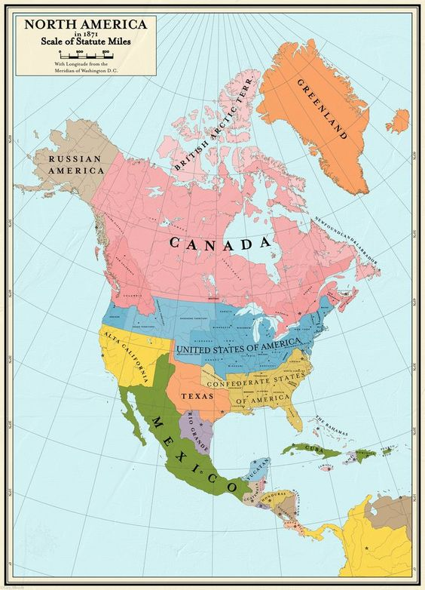
♦ Cultural Identity: The geographical position of Canada in the world intensely affects many Canadian writers. French Canadians always feel themselves surrounded by their English-speaking neighbours. So, they feel a kind of insecurity and have made an unwavering effort to defend their own culture and institutions. And surprisingly, English Canadians do not have a similar feeling of being surrounded by the people and culture of the United States and terrified of them.

Slide 32
♦ Social Issues: Canadian authors often address pressing social and political issues, such as indigenous rights, environmental conservation, gender equality, healthcare, and the impact of colonization.

Slide 33
It's important to note that Canadian literature is incredibly diverse, and not all works will exhibit all of these characteristics. Additionally, the Canadian literary landscape has evolved over time, with contemporary authors exploring new themes and techniques that reflect the changing nature of Canadian society.

Slide 34
4- Famous Canadian Novels and Writers :
Canadian literature boasts a wealth of famous novels, many of which have received international acclaim and are considered significant works in the world of literature. Here are some of the most renowned Canadian novels:

Slide 35
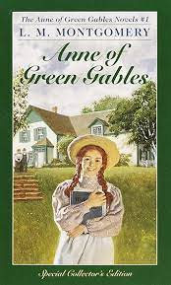
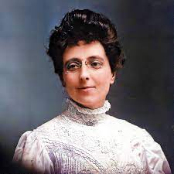
"Anne of Green Gables" by Lucy Maud Montgomery - This beloved classic tells the story of Anne Shirley, an orphan who finds a home in Green Gables, Prince Edward Island. The novel has captured the hearts of readers worldwide.

Slide 36
"The Handmaid's Tale" by Margaret Atwood - This dystopian novel envisions a future society where women's rights have been severely restricted. It has gained widespread recognition and was adapted into a successful television series.

Slide 37
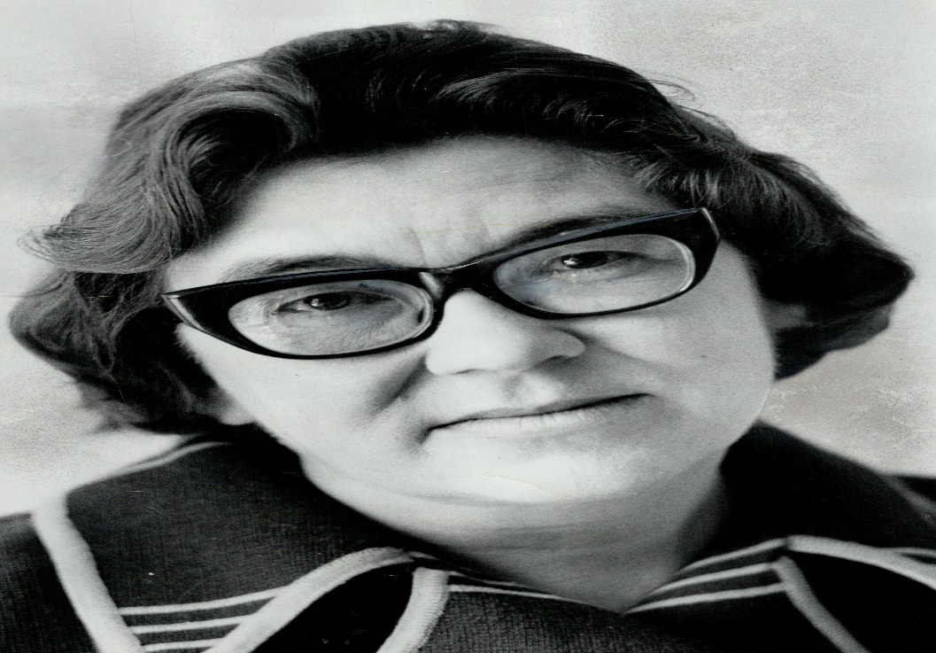
This novel is a powerful exploration of the life of Hagar Shipley, an elderly woman reflecting on her past in rural Manitoba. It is considered a classic of Canadian literature.
"The Stone Angel" by Margaret Laurence

Slide 38
"Alias Grace" by Margaret Atwood - This historical novel is based on the true story of Grace Marks, a convicted murderer in 19th-century Canada. Atwood's masterful storytelling blurs the lines between innocence and guilt.

Slide 39
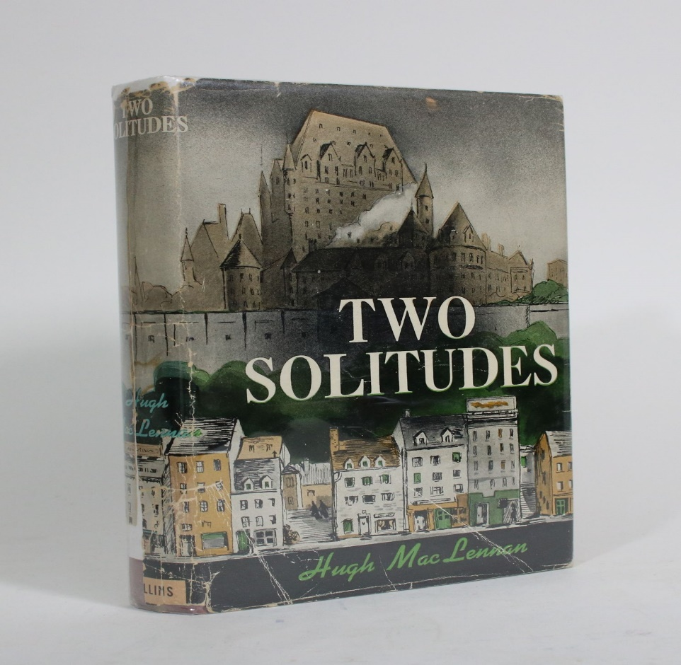
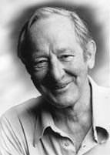
"Two Solitudes" by Hugh MacLennan - This novel explores the cultural and linguistic divides in Canada, particularly between English and French Canadians. It is a significant work in Canadian literature.

Slide 40
These are just a few examples of the many exceptional novels in Canadian literature. Canada has a rich literary tradition, and its authors have made significant contributions to the global literary landscape.

Slide 41
5- The Themes of Canadian Literature
Search for Identity : The country's own struggle to define its identity is mirrored in the experiences of its literary characters, who search for self-definition. Characters define and redefine themselves within a changing society, where the value systems of a new nation interact with the character's own experiences, expectations, and inevitable conflicts that arise.

Slide 42
Isolation : In the face of an often harsh environment, and confusion of cultures, figures in Canadian literature often develop a sense of isolation from those around them or experience feelings of alienation from a society that appears indifferent to their situation.

Slide 43
Illusion Vs. Reality : Whether seeking to escape persecution or desiring to prove their independence, all people who emigrated to North America share the dream that, here, one may begin again. Once here however, when faced with the reality of survival in a sometimes harsh physical and social environment, some characters lose sight of their dream while others wrap themselves in its security and refuse to see the truth.

Slide 44
The Garrison Mentality : Common theme in both English Canada and French Canadian literature and cinema characters are always looking outwards and building metaphorical walls against the outside world. this mentality is assumed to come from part of the Canadian identity that fears the emptiness of the Canadian landscape and fears the oppressiveness of other nations (especially the United States).

