Slide 1
Minaret by Leila Aboulela by: Hazzar Ihab Bensana Raid

Slide 2
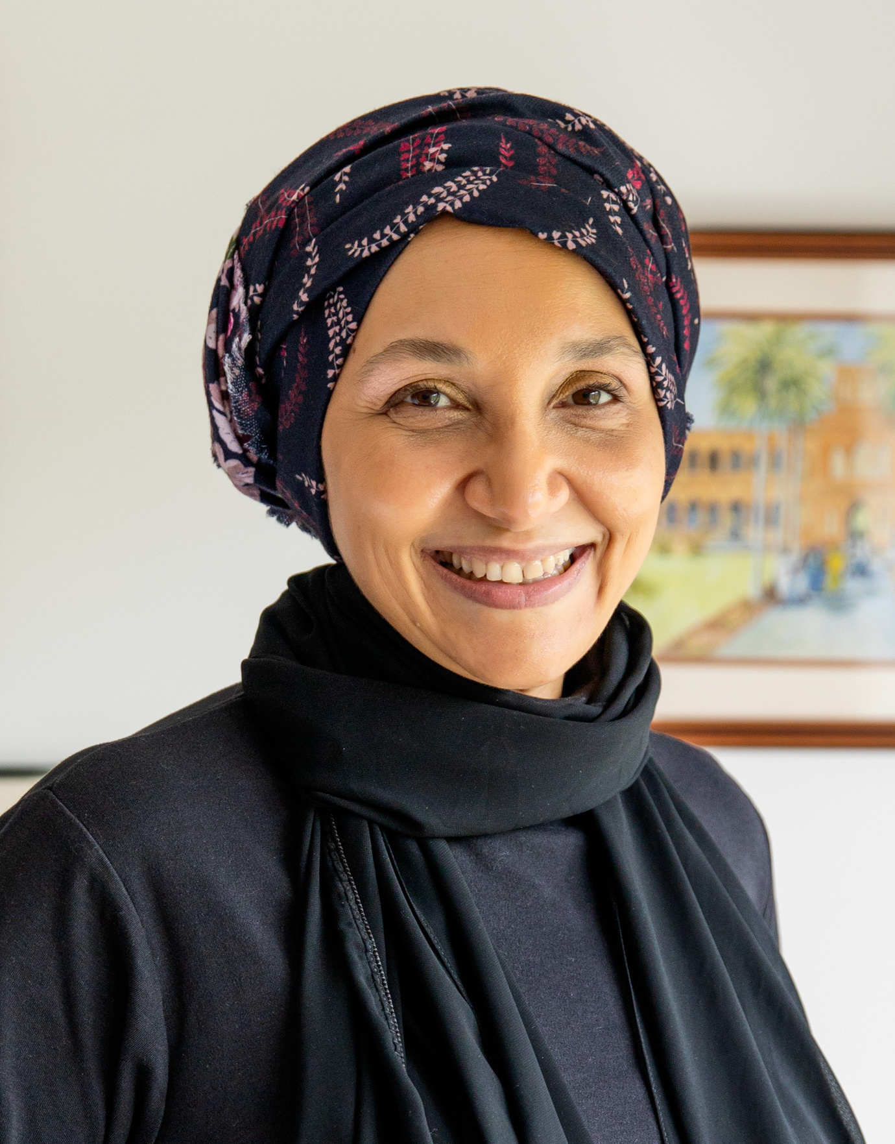
Biography of the author:
Leila Aboulela, a Sudanese-British writer, was born in Cairo in 1964 and attended Khartoum American School before moving to Aberdeen, Scotland, where she earned an Economics degree.
She wrote Arabic fiction, focusing on Muslim immigrants and cultural clashes. Her 1999 novel, The Translator, won the Caine Prize for African Writing.
Aboulela's novels explore identity, religion, spirituality, and home, often focusing on characters navigating their Islamic faith and Sudanese background in Western society.

Slide 3
Summary of the story:
The novel follows Najwa, a Sudanese woman forced to work menial jobs as a maid and nanny for an upper-class Arab family after a military coup.
Najwa embraces Islam and becomes a religious caretaker for an aristocratic Arab daughter. She struggles with her attraction to the girl's westernized older brother, Tamer, as she adjusts to her new life.
The novel explores Najwa's inner conflict, reconciling Muslim beliefs with her love for Tamer, and her struggle to find her identity as a devout Muslim and immigrant in a privileged world.

Slide 4
Characters:
The novel's protagonist, Najwa, a privileged Sudanese woman, struggles to reconcile her love for Tamer with her religious beliefs after immigrating to London.
Tamer, The westernized secular brother of Najwa’s employer whom she find attractive but hesitant to marry due to her religious beliefs.
Ommy Hani, Najwa's devout friend, introduces her to strict Islam practices and disapproves of her feelings for Tamer.
Anwar, Najwa's university boyfriend, immigrated to London and, despite being Sudanese, has adopted a more western lifestyle.
Waqas - A conservative Muslim preacher who lectures at the Regent's Park Mosque. He eventually marries Najwa.
Najwa's Mother - A once-wealthy woman who was forced to flee Sudan with her family and is desperate to regain her former social status.
Najwa's Father - A political activist who was persecuted in Sudan. Sinking into depression in London, he divorces Najwa's mother.
Lady Nabilah - Najwa's wealthy Sudanese employer who makes her serve at parties with people she formerly socialized with as an equal.
Aliyah - The young daughter Najwa cares for. She represents the next generation of privileged Arab youth.

Slide 5
Themes:
Identity and Belonging: The novel explores the challenges faced by Najwa, a Sudanese Muslim woman, as she tries to find her place and identity in the UK after her family's downfall in Sudan.
Faith and Religion: The story delves into Najwa's struggles with her Muslim faith and how she seeks solace and guidance within it, navigating the complexities of faith in a secular society.
Social Class and Displacement: The book highlights the stark contrast between Najwa's family's previous life of privilege in Sudan and their refugee status in the UK, shedding light on the disparities in social class and the experience of displacement.
Family and Relationships: The novel examines the dynamics within Najwa's family and her evolving relationships with family members, particularly her nephew, as they adapt to a new culture.
Love and Romance: A central element of the novel is the love story between Najwa and a fellow Sudanese Muslim, exploring the complexities of romantic relationships within the context of cultural and religious expectations.

Slide 6
Themes:
Tradition vs. Modernity: The clash between traditional values and the modern world is a recurring theme, reflecting Najwa's struggle to reconcile her Sudanese heritage with the secular and modern society she encounters in the UK.
Redemption and Resilience: Najwa's journey throughout the novel is marked by personal growth, resilience, and a quest for redemption for past mistakes and regrets.
Cultural and Religious Stereotypes: The novel challenges stereotypes and misconceptions about Islam and Muslims, providing a nuanced view of the diversity of experiences within the Muslim community.

Slide 7
The symbols:
Minaret: Symbolizes Najwa's connection to her Islamic faith and her longing for her past life in Sudan before her exile in London.
The Quran and Islamic Prayer: Represent Najwa's faith and cultural identity, providing her with solace and guidance in her new life.
Traditional Sudanese Clothing: The jalabiya and hijab symbolize cultural and religious identity for Najwa and other characters, connecting them to their Sudanese heritage.
The River Nile: Symbolizes Najwa's nostalgia and longing for her homeland, serving as a reminder of Sudan's rich history and culture.
The London Landscape:Represents the clash between cultures and the challenges of adapting to a new environment, highlighting the differences between Najwa's past life in Sudan and her current life in London.

Slide 8
Style of Language:
Concise and Descriptive Prose: Aboulela's writing is straightforward and uses vivid descriptions to create a clear sense of settings and characters.
First-Person Narrative: The novel is narrated in the first person, offering an intimate look into the thoughts and emotions of the protagonist, Najwa.
Cultural Sensitivity: The author demonstrates a deep understanding of Sudanese culture and Islam, presenting them with respect and sensitivity.
Subtle Symbolism: Symbolism is used in a subtle and understated manner, allowing readers to uncover its meaning gradually.
Reflective and Thoughtful: The narrative includes Najwa's introspective thoughts and reflections, adding depth to the story.
Sensory Details: Aboulela employs sensory details to immerse readers in the story, vividly depicting the sights, sounds, and scents of the different settings.
Realistic Dialogues: The dialogues are authentic and mirror real-life speech, contributing to the realism of the characters and their interactions.

Slide 9
“Thanks For your attention”

