Slide 1
The African Novel
Dr. N. BOUALLEGUE

Slide 2
The transition to modernity
The didactic aspect has lost its great importance in this phase .An emphasis on the aesthetic effect of literature has marked the period.
“the aesthetic principle came to override the didactic impulse that motivated the early writers. For the expressive potential of the Old Testament and its recall of African orality proved influential in determining the narrative rhetoric and forms of fictional address in many of the indigenous novels” (4).

Slide 3
The influence of Christianity
A Combination between: Old Testament and African orality.
“Thomas Mofolo’s Sotho novel, Chaka, composed in the Sotho language, a work which, despite its conflicted portrayal of the Zulu hero, derives its narrative impulse from its integration of the praise poem tradition into a prose narrative form, a re-creation compelled by its historical theme and cultural reference” (5).

Slide 4
John Bunyan’s The Pilgrim's Progress
is a 1678 Christian allegory written by John Bunyan. It is regarded as one of the most significant works of religious, theological fiction in English literature. It has been translated into more than 200 languages.
“Bunyan’s work was able to exert such an influence not so much through the Christian orthodoxy of its content as by virtue of its quest motif and its allegorical burden, which bore a recognizable affinity to the didactic and symbolic function of the African folk tale tradition” (5) .

Slide 5
The impact of Islam
Koran is «a normative reference for modern African fiction in Arabic, represented by works such as Tayeb Salih’s Season of Migration to the North, and in particular, the novels of Naguib Mafouz”.
The influence of the Koran extends, however, beyond the literature in Arabic.
“The so-called Afro-Arab literature in Swahili and Hausa which was enabled by the transcription of African languages into the Arabic script (ajami), was predominantly devotional in tone” (5).

Slide 6
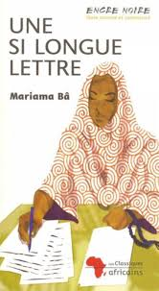
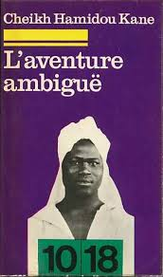
Koran and European languages
Cheikh Hamidou Kane
Mariama Bâ

Slide 7
The modern African novel
« The transition to modernity registered by the thematic and formal evolution of the African novel in the indigenous languages brings the corpus into convergence with the works that have defined the trajectory of the African novel written in European languages, principally Portuguese, French and English” (6).

Slide 8
The Lusophone African Novel
In lusophone Africa, the beginnings of the novel are to be traced to “white writing”. Examples.
“These works have been said to bear a close relationship to the novelistic tradition in Northeast Brazil, exemplified by the work of Jorge Amado”.
“the novel came to serve as a major vehicle of anti-colonial protest and of a nationalist sentiment that also found intense lyrical expression in poetry” (7).

Slide 9
The Francophone African Novel
“the consistently negative image of Africa purveyed by the French colonial novel rendered it superficial as a representation of the peoples and cultures of the continent. Moreover, the entrenched racism and ideological motivation that shaped its conception, as in Pierre Loti’s Le roman d’un Spahi, could not but provoke the reaction marked by René Maran’s Batouala, published in 1921” (7).

Slide 10
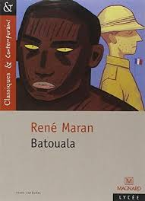
René Maran’s Batouala
Despite the derivation of Batouala from the French colonial novel, of which it retains many of the formal features, Maran’s effort to render an African point of view, to create living African characters in a genuine context of life served as a model that was soon adopted by other writers. Batouala thus marks the beginning of the francophone African novel.

Slide 11
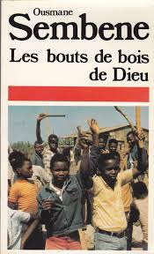
The Francophone African Novel
-The remarkable blossoming
of fictional writing in French took place after World War II, illustrated notably by the works of Camara Laye, Mongo Beti, Ferdinand Oyono, Ousmane Sembène and Cheikh Hamidou Kane.
- « The interest of these novels is not, however, limited to their nationalist orientation but derives as well from their achievement in artistic terms, for they display a resourceful handling of a language and tradition of fictional writing taken over from the metropolitan masters” (7).

Slide 12
The Anglophone African Novel
Aphrah Behn’s Oroonoko or the Royal Slave published in 1688, appears as the ancestor to the colonial novel in English.
It was colored by the denigration of Africa
and the black race generally.
Similar images were to be found in the novels of Henry Rider Haggard and Joyce Cary, and in particular Joseph Conrad’s novella, Heart of Darkness.

Slide 13
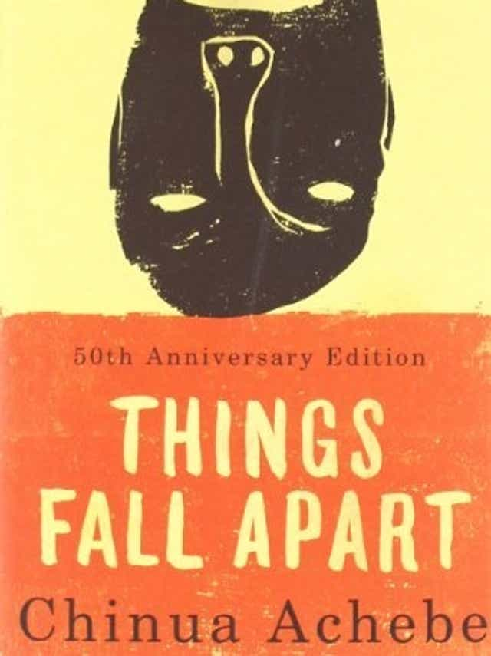
Things Fall Apart (1958)
The value of the work stems from the narrative projection of African life that manifests skill and maturity of the style. Achebe’s work and its emphasis on socio-political themes are reminiscent of early works such as Hayford’s Ethiopia Unbound (1911).
Both works oppose the dominance of Europeans in politics and ask for the integration of the African self.

Slide 14
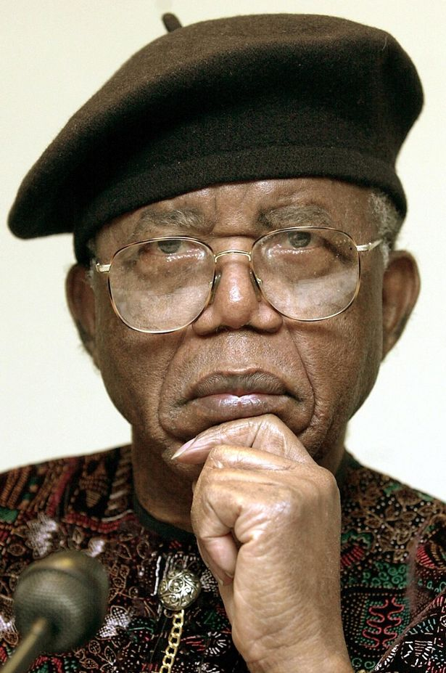
Chinua Achebe
“It is in Achebe’s work that the African experience is brought into definite focus, and assumes its full human and narrative scope in the modern novel. His redefinition of the terms of the fictional representation of Africa established the novel as a modern narrative genre on the African continent” (9).

Slide 15
The Africanization of the novel
“The native grasp of an Igbo ethos of communal living and individual awareness that underlies and legitimizes Achebe’s imaginative expression has given powerful impulse to the effort by other writers to convey the sense of a specific location in the world that his work evinces”.
“His influence in this regard has been evident in the work of the cluster of Igbo novelists who may be said to constitute a school spawned by his example. The names that come to mind include Flora Nwapa, Onuora Nzekwu, John Munonye, and most memorably, Elechi Amadi, whose compelling novel, The Great Ponds, represents the most convincing effort deployed by this group in the ethnographic grounding of the African novel” (9).

Slide 16
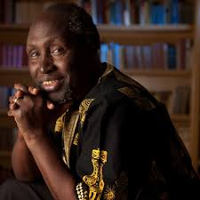
Ngũgĩ wa Thiong'o
But the example of Achebe has been extended in other directions by non-Igbo writers such as T. M. Aluko and especially by Ngugi
wa Thiong’o, for whom an affective bond with Kikuyu culture and traditions provides the foundation for his imaginative reliving of the Kenya Emergency
in his first three novels.
«I was wondering why I was put in prison for working in an African language when I had not been put in prison for working in English. So really, in prison I started thinking more seriously about the relation between language and power.”

Slide 17
The African Short Fiction
African writers have also proved accomplished practitioners of short fiction. Birago Diop and Bernard Dadié have drawn inspiration from the oral tradition and excelled in the conte, through their transpositions of the African folk tale into French, while other writers have employed the conventional Western form of the short story or nouvelle, constructed around a single incident or emotional moment of great significance (9).

Slide 18
The short story
The principal figures in the development of the short story as a subgenre of the African novel are Ousmane Sembène (Voltaïques) and Henri Lopès (Sans Tam-Tam) on the francophone side, and on the anglophone, Grace Ogot, Charles Mungoshi (The Setting Sun and Rolling Hills), and especially the South Africans, who have excelled in the genre: Nadine Gordimer, Ezekiel Mphahlele, Richard Rive, Alex La Guma, Njambulo Ndebele, Mzamane Mbulelu.

Slide 19
The end of colonialism: new thematic concerns
“The formal end of colonialism has imprinted a striking new character on the thematic concerns of the African writer, commanded as these are at the present time by the dilemmas of the post-independence situation”.
“the new realism”.
the postcolonial condition has determined a strong dystopian current (10).

Slide 20
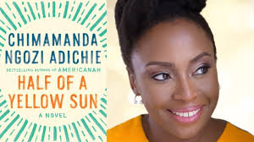
Women and the African novel
The thematic orientation of women’s literature in Africa is provided by the
changing perceptions by African women of their social condition in relation to such issues as polygamy and male domination, and their quest for fulfilment and for a meaningful place in modern society through access to education and full participation in the economic life and national politics in the new African states. These themes are encompassed in the novels of Mariama Bâ’s Ama Ata Aidoo, Buchi Emecheta, and more recently Amma Darko.

