Slide 1
Important Figures in Postcolonial Theory
By Dr. N. BOUALLEGUE

Slide 2
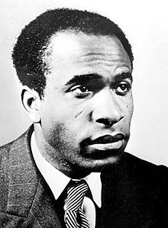
Frantz Fanon (1925–1961)
Fanon is the leading figure of the first generation of Postcolonial theorists. Born on the French island colony of Martinique, Fanon fought against Nazism in France where he subsequently trained as a psychiatrist. His origins and his experience in both Martinique and France exposed him to the issues of racism and colonialism.

Slide 3
Black Skin, White Masks
Peau noire, masques blancs (1952), translated as Black Skin, White Masks (1967) explores the psychological effects of racism and colonialism.
The book touches on anti-Black racism and how it forms, then deforms, the subjectivity of white and Black people both, is crucial for understanding the multiple levels of colonial subjugation and the terms of its overcoming.

Slide 4
Quotes: Black Skin, White Masks
“The neurotic structure of an individual is simply the elaboration, the formation, the eruption within the ego, of conflictual clusters arising in part out of the environment and in part out of the purely personal way in which that individual reacts to these influences”.
“The black man wants to be white. The white man slaves to reach a human level”.

Slide 5
Frantz Fanon: Algeria
In 1954, while Fanon was working as a psychiatrist in Algeria he edited the National Liberation Front’s newspaper and remained involved in the revolution until his death in 1961.
Fanon produced a number of writings connected with Algerian and African revolution; his most comprehensive and influential work was Les Damnés de la terre (1961), translated as The Wretched of the Earth (1963).

Slide 6
The Wretched of the Earth
This now classic text analyzed the conditions and requirements for effective anti-colonial revolution from a Marxist perspective, modified somewhat to accommodate conditions specific to colonized nations. In an important chapter called “On National Culture”, Fanon addresses the important connections between the struggle for freedom and the various elements of culture, including literature and the arts. Colonialism, says Fanon, entirely disrupts the cultural life of a conquered people.

Slide 7
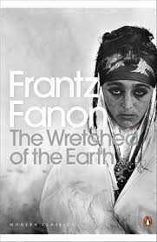
“In the colonies the economic infrastructure is also a superstructure. The cause is effect: You are rich because you are white, you are white because you are rich. This is why a Marxist analysis should always be slightly stretched when it comes to addressing the colonial issue”.

Slide 8
“literature of combat”
It is only when national consciousness reaches a certain stage of maturity that we can speak of a national literature, a literature which takes up and explores themes that are nationalist. This literature, says Fanon, is a “literature of combat” because “it calls on the whole people to fight for their existence as a nation,” and “molds the national consciousness” Hence literature is not merely a superstructural effect of economic struggle: it is instrumental in shaping the nation’s conscious articulation of its own identity and the values at stake in that struggle.

Slide 9

Edward Said (1935–2004)
Said is a literary and cultural theorist, born in Jerusalem, Palestine.
Said’s Orientalism (1978) is his most celebrated and debated work. It reflects concerns of the second wave of Postcolonial Studies.

Slide 10
‘Orientalism’
It designates first the 4000-year history of and cultural relations between Europe and Asia; second the scientific discipline producing specialists in Oriental languages and culture from the early nineteenth century; and third the long-term images, stereotypes and general ideology about ‘the Orient’ as the ‘Other’, constructed by generations of Western scholars.

Slide 11
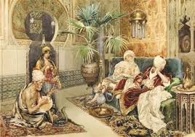
The Orient
It is a production of Western discourse, a means of self-definition of Western culture as well as of justifying imperial domination of Oriental peoples. Said attempts to examine the stereotypes and distortions through which Islam and the East have been consumed. These stereotypes include: Islam as a heretical imitation of Christianity, Islam as a culture incapable of innovation.

Slide 12
America vs The Arab World
Said suggests that the electronic postmodern world reinforces dehumanized portrayals of the Arabs, a tendency both aggravated by the Arab–Israeli conflict and intensely felt by Said himself as a Palestinian.
“It is quite common to hear high officials in Washington and elsewhere speak of changing the map of the Middle East, as if ancient societies and myriad peoples can be shaken up like so many peanuts in a jar.”

Slide 13
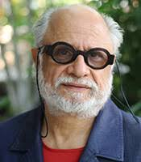
Homi K. Bhabha (b. 1949)
He is an Indian English scholar and critical theorist.
He is one of the most important figures in contemporary postcolonial studies and has developed a number of the field's neologisms and key concepts, such as hybridity, mimicry, difference, and ambivalence.

Slide 14
‘hybridity’
Homi Bhabha extends certain tenets of poststructuralism into discourses about colonialism, nationality, and culture. These tenets include a challenging of the notion of fixed identity, and the undermining of binary oppositions. The notion of “hybridity” is central to Bhabha’s work in challenging notions of identity, culture, and nation as coherent and unified entities that exhibit a linear historical development. The concept is embodied in Bhabha’s own life (as in the lives of many intellectuals from colonial nations who have been raised in Western institutions): born in Bombay, India, he was educated both in his native country and at Oxford University; he subsequently taught at universities in England and America.

Slide 15
“The Commitment to Theory”
In his important essay “The Commitment to Theory” (1989), Bhabha attempts to respond to recent charges that literary and cultural theory (including deconstruction, Lacanianism, and the various tendencies of poststructuralism) suffers from a defect: it is inscribed within, and complicit with, a Eurocentric and imperialist discourse; and, as such, it is detached from the real concerns, the “historical exigencies and tragedies” of third world peoples.

Slide 16
The Location of Culture
Of special interest to him is the way in which subjugated races mimic their subjugators. These ideas are explored especially in the volume The Location of Culture (1994). There are examples of such ‘mimics’ in several well known works of literature which trace the relations between the British and the Indians: in the works of Rudyard Kipling, such as Kim, and in E M Forster’s A Passage to India. The HYBRID subject is the subject of a discourse of mimicry, forced to speak from multiple, typically antagonistic locations.

Slide 17
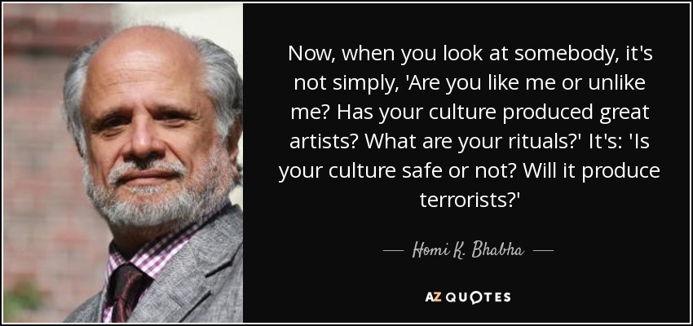
Quote

