Slide 1
Postcolonial Literary Criticism
Dr. N. BOUALLEGUE

Slide 2
Introduction
Postcolonial literary criticism is an approach to literature that focuses on the study of literary texts produced in countries and cultures that were subject to European colonial powers. It can also refer to the analysis of texts written about colonized places and people by writers of the colonizing culture. Postcolonial literature and criticism arose both during and after the struggles of many nations in Africa, Asia, Latin America and elsewhere for independence from colonial rule.

Slide 3
Major Postcolonial Texts
The year 1950 saw the publication of seminal texts of postcolonialism: Aimé Césaire’s Discours sur le colonialisme, and Frantz Fanon’s Black Skin, White Masks. And in 1958 Chinua Achebe published his novel Things Fall Apart. According to the critic Robert Young, the “founding moment” of postcolonial theory was the journal the Tricontinental, launched by the Havan Tricontinental of 1966, which “initiated the first global alliance of the peoples of the three continents [Africa, Asia, Latin America] against imperialism”. Edward Said’s landmark work Orientalism appeared in 1978.

Slide 4
The term ‘postcolonialism’
Robert Young sees postcolonialism as continuing to derive its inspiration from the anti-colonial struggles of the colonial era. Ashcroft, Griffiths, and Tiffin also use the term postcolonial in a comprehensive sense, “to cover all the culture affected by the imperial process from the moment of colonization to the present day,” on account of the “continuity of preoccupations” between the colonial and postcolonial periods.

Slide 5
Aims of Postcolonial theory
Postcolonial criticism , Young argues, has embraced a number of aims: most fundamentally, to reexamine the history of colonialism from the perspective of the colonized; to determine the economic, political, and cultural impact of colonialism on both the colonized peoples and the colonizing powers; to analyze the process of decolonization; and above all, to participate in the goals of political liberation, which includes equal access to material resources, the contestation of forms of domination, and the articulation of political and cultural identities .

Slide 6
“Internal colonization”
Postcolonial discourse potentially embraces, and is intimately linked with, a broad range of dialogues within the colonizing powers, addressing various forms of “internal colonization” as treated by minority studies of various kinds such as African-American, Native American, Latin American, and Asian American. All of these discourses have challenged the main streams of Western philosophy, literature, and ideology. This challenge is revealed in the questioning and revaluation of the literary and cultural canon in Western institutions, through what is called “multiculturalism.”

Slide 7
Multicultural literature
Multicultural literature is defined as writing in English about North American ethnic, cultural and religious minority groups .It signifies texts carrying in one way or another images of migrant experiences. Minority groups want to have a voice through developing a unique artistic style as a defense mechanism in opposition to the dominant culture.

Slide 8
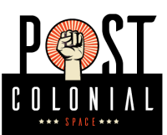
Key concepts in postcolonial theory

Slide 9
APPROPRIATION:
A term used to describe the ways in which post-colonial societies take over those aspects of the imperial culture – language, forms of writing, film, theatre, even modes of thought and argument such as rationalism, logic and analysis – that may be of use to them in articulating their own social and cultural identities. This process is sometimes used to describe the strategy by which the dominant imperial power incorporates as its own the territory or culture that it surveys and invades. However, post-colonial theory focuses instead on an exploration of the ways in which the dominated or colonized culture can use the tools of the dominant discourse to resist its political or cultural control.

Slide 10
DISLOCATION:
A term for both the occasion of displacement that occurs as a result of imperial occupation and the experiences associated with this event. The phenomenon may be a result of transportation from one country to another by slavery or imprisonment, by invasion and settlement, a consequence of willing or unwilling movement from a known to an unknown location. Besides the geographical dislocation, postcolonial subjects can also endure a cultural dislocation. They are metaphorically dislocated, placed into a hierarchy that sets their culture aside and ignores its institutions and values in favor of the values and practices of the colonizing culture.

Slide 11
ETHNICITY:
It is a term that has been used increasingly since the 1960s to account for human variation in terms of culture, tradition, language, social patterns and ancestry, rather than the discredited generalizations of race with its assumption of a humanity divided into fixed, genetically determined biological types. Ethnicity refers to the fusion of many traits that belong to the nature of any ethnic group: a composite of shared values, beliefs, norms, tastes, behaviors, experiences, consciousness of kind, memories and loyalties.

Slide 12
HYBRIDITY :
The term ‘hybridity’ has been most recently associated with the work of Homi K.Bhabha, whose analysis of colonizer/colonized relations stresses their interdependence and the mutual construction of their subjectivities. Bhabha contends that all cultural statements and systems are constructed in a space that he calls the ‘Third Space of enunciation’. Hybridity has frequently been used in post-colonial discourse to mean simply cross-cultural ‘exchange’. This use of the term has been widely criticized. The criticism of the term stems from the perception of theories which believe that mutuality necessarily downplay opposition, and increase continuing post-colonial dependence.

Slide 13
LIMINALITY:
: The importance of the liminal for post-colonial theory is precisely its usefulness for describing an ‘in-between’ space in which cultural change may occur: the transcultural space in which strategies for personal or communal self-hood may be elaborated, a region in which there is a continual process of movement and interchange between different states. For instance, the colonized subject may dwell in the liminal space between colonial discourse and the assumption of a new ‘noncolonial’ identity. But such identification is never simply a movement from one identity to another; it is a constant process of engagement, and appropriation.

Slide 14
THE OTHER:
In general terms, the ‘other’ is anyone who is separate from one’s self. The existence of others is crucial in defining what is ‘normal’ and in locating one’s own place in the world. The colonized subject is characterized as ‘other’ through discourses such as primitivism and cannibalism, as a means of establishing the binary separation of the colonizer and colonized and asserting the naturalness and primacy of the colonizing culture and world view. It refers to the colonized others who are marginalized by imperial discourse, identified by their difference from the centre.

Slide 15
Cultural identity:
is the sense of belonging towards a culture. This belonging can be justified with the shared set of companionship, principles or beliefs of living.Basically, it can be considered as owning the culture and its various boundaries of ethnicity, nationality, language, religion, and gender. And owning the culture means that the person embraces all the traditions that have been passed down throughout history. The cultural identity reveals the person’s heritage, as well as help identify with others who have the same traditions or similar belief structures.

Slide 16
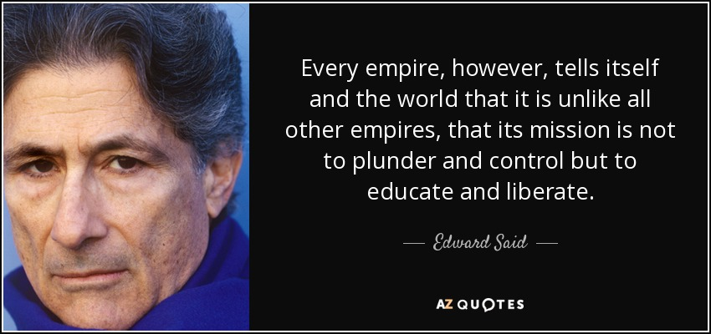
Quote

