Slide 1
Feminist Literary Theory
First Wave
Dr. Nadjiba Bouallegue

Slide 2
Introduction:
Feminist literary criticism is a political attack upon other modes of criticism and theory. Feminism is concerned with difference and marginalization of women. Feminists believe that our culture is a patriarchal culture, that is, one organized in favor of the interests of men. They try to describe and interpret (and reinterpret) women’s experiences as depicted in various kinds of literature- especially the novel, to a lesser extent poetry and drama.

Slide 3
Development of Feminist Literary Criticism:
First-wave feminist criticism: Woolf and de Beauvoir
The Women’s Rights and Women’s Suffrage movements were the crucial determinants in shaping this phase, with their emphasis on social, political and economic factors. Feminist criticism of this period is more a reflex of ‘first-wave’ preoccupations than a fully fledged theoretical discourse of its own. But two significant figures may be selected from among the many other feminists working and writing in this period (e.g. Olive Schreiner, Elizabeth Robins, Dorothy Richardson, Katherine Mansfield, Rebecca West, Ray Strachey, Vera Brittain and Winifred Holtby): Virginia Woolf and Simone de Beauvoir.

Slide 4
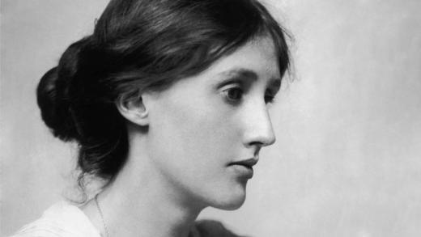
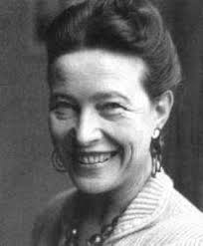
Virginia Woolf
Simone de Beauvoir

Slide 5
Virginia Woolf
Virginia Woolf’s fame conventionally rests on her own creative writing as a woman; feminist critics have analyzed her novels extensively from very different perspectives. She produced a key text which is a major contribution to feminist theory, A Room of One’s Own (1929). Like other ‘first-wave’ feminists, Woolf is principally concerned with women’s material disadvantages compared to men. Woolf’s Room of One’s Own was a landmark work in which representations of women by male authors are roundly criticized and a new model for female IDENTITY and AGENCY is proffered. Woolf also insisted that women be allowed the economic and social freedom to follow their aspirations and to forego the traditional role of serving as an enlarging mirror for male identity.

Slide 6
Virginia woolf’s feminism
Woolf’s general contribution to feminism, then, is her recognition that gender identity is socially constructed and can be challenged and transformed, but apropos of feminist criticism she also continually examined the problems facing women writers. She believed that women had always faced social and economic obstacles to their literary ambitions, and was herself conscious of the restricted education she had received (she was taught no Greek, for example, unlike her brothers).

Slide 7

«Professions for Women »
One of Woolf’s most interesting essays about women writers is ‘Professions for Women’, in which she regards her own career as hindered in two ways. First, she was imprisoned and constrained by the dominant ideologies of womanhood. Second, the taboo about expressing female passion prevented her from ‘telling the truth about [her] own experiences as a body’.

Slide 8

Simone de Beauvoir
French feminist, lifelong partner of Jean-Paul Sartre, pro-abortion and women’s-rights activist, founder of the newspaper Nouvelles féministes and of the journal of feminist theory, Questions feminists – marks the moment when ‘first-wave’ feminism begins to slip over into the ‘second wave’.

Slide 9
The Second Sex (1949)
While Simone de Beauvoir’s hugely influential book The Second Sex (1949) is clearly preoccupied with the ‘materialism’ of the first wave, it beckons to the second wave in its recognition of the vast difference between the interests of the two sexes and in its assault on men’s biological and psychological, as well as economic, discrimination against women.
De Beauvoir’s work carefully distinguishes between sex and gender, and sees an interaction between social and natural functions: ‘One is not born, but rather becomes, a woman . . . it is civilization as a whole that produces this creature . . . Only the intervention of someone else can establish an individual as an Other.’

Slide 10
The Concept of the « Other »
Simone de Beauvoir used the concept of “the Other” to describe a male-dominated culture that reflects Woman as the sexual Other to Man. In a patriarchal culture, the Man-Woman relation is society's normative binary-gender relation, wherein the sexual Other is a social minority with the least socio-political power, usually the women of the community, because patriarchal semantics established that "a man represents both the positive and the neutral, as indicated by the common use of [the word] Man to designate human beings in general; whereas [the word] Woman represents only the negative, defined by limiting criteria, without reciprocity" from the first sex, from Man.

Slide 11
Quotes:
“Lock up your libraries if you like; but there is no gate, no lock, no bolt that you can set upon the freedom of my mind.”
Virginia Woolf
“No need to hurry. No need to sparkle. No need to be anybody but oneself.”
Virginia Woolf

