Slide 1
Introduction to Literary Theory
By
Dr. BOUALLEGUE NADJIBA

Slide 2
Introduction:
When we are asked to discuss literary theory, a bunch of (mostly foreign) names crosses our mind, names like Michel Foucault, Helene Cixous, Edward Said, Jacques Derrida, Judith Butler, Luce Iragaray. Their works are not a reflection on the nature of literature or a discussion of the forms and techniques of writing. These writers’ relation to literature is barely evident; they are more interested in non-literary matters as psychoanalysis, politics, and philosophy.

Slide 3
Definition of the term ‘theory’
Theory is the capacity to generalize about phenomena and to develop concepts that form the basis for interpretation and analysis. The mode of thought suggested by this working definition involves the ability first to think generally about a given set of phenomena (language, social relations, women’s experience, the novel as a form); second to develop theoretical concepts (or models) based on assumptions and principles governing the inclusion of elements within the set and the relations between those elements; and, finally, to use these concepts as the starting point from which to interpret and analyze specific instances within a set (the function of metaphor, capitalism, female gender roles, the Bildungsroman).

Slide 4
Definition of literary theory
Literary theory describes the set of interpretive tools that help us think more deeply and insightfully about
the literature that we read.

Slide 5
The Aim of Literary Theory:
- Literary criticism grew out of man’s desire to understand the other and the other’s language.
- However, in order to understand the voices of others we need to read critically the various texts that tell usabout human nature and experiences.
- Reading and discussing literature can enhance our ability to write, expand our sense of what is possible and improve our ability to empathize with others. It can sharpen our critical faculties, enabling us to assess works and better understand why literature can have such a powerful effect on our lives

Slide 6
Short History of Literary Theory
Greek Origins:
-Both Plato and Aristotle set the agenda for subsequent tradition of criticism (all modern philosophy (and
criticism) is based on their views).
- Aristotle’s Poetics is devoted to drama (tragedy in particular).
- Plato’s theories of literature, in Republic are somehow instances of literary criticism (Plato indeed warned
against poetry for its harmful effect on children)

Slide 7
The Romans:
The Romans wrote works that could be considered forms of criticism:
Horace’s Ars Poetica (19 BC),
Cicero and Quintilian composed works on rhetoric.
In the Christian era: the most important critical essay is Longinus’s “On the Sublime”
In the medieval Era the notable critic was Dante who addressed the problems of language appropriate to
poetry.

Slide 8
The Renaissance Era:
17th and 18th Century:
Marco Vida’s Poetica (1527) about the art of poetry
Lope de Vega’s New Art of Making Comedies (1609)
In England, Philip Sidney’s Apologie for Poetrie (1595) is an important work because it is a detailed
examination of the art of poetry and a discussion of the state of English poetry at the time.
17th century important works were Ben Johnson’s Timber: or Discoveries (1640), Pierre Corneille’s Discourse
(1660).
Late 17th century and early 18th century (Romanticism), there was a very pronounced emphasis on following
the rules in the creation of literature and a considerable emphasis on imitating the laws of nature.
(Alexander Pope)

Slide 9
18th Century Reaction against Neoclassicism:
Historicism completely changed critical methods. It enabled people to realize that the rules that held good
for the classical writers are not necessarily hold good in a later age, and that there were not absolute
principles and rules by which literature could be judged.
The era witnessed the emergence of a variety of opinions about literature, about the language to be used,
and about the creative and imaginative faculties and processes of the writer).
illiam Wordsworth’s Lyric Ballads (1800), Samuel Taylor Coleridge’s Biographia Literaria (1817), Percy
Bysshe Shelly’s Defence of Poetry (1821), Edgar Allen Poe’s The Poetic Principle (1850) and The Philosophy of
Composition (1846), are examples of eighteenth century contribution to literary criticism.

Slide 10
Mid-19th Century:
By the mid 19th century different theories of literature appeared such as “Aestheticism,” “Art for art’s sake,”
and “Symbolism”
There were fewer rules of any kind as more and more writers experimented.

Slide 11
Contemporary Theory
Important voices include: M. H. Abrams, Eric Auerbach, Roland Barthes, Cleanth Brooks, T. S. Eliot,
Northrope Frye, F. R. Leavis, George Luckacs, Ezra Pound, John Crowe Ransom, I. A. Richards, Jean-Paul
Sartre, Allen Tate, Raymond Williams, W. K. Wimsatt and many others.

Slide 12
Types of Literary Criticism
Introduction:
* Since ancient times, readers have debated and critiqued literature from a variety of perspectives.
* Some have looked at a story or play from a moral stance, considering how values are represented in a text.
*Another critic might evaluate a poem in terms of its form.
*Recent critics have looked at literature to see what it might be saying about our lives in society, our political
or power relations, gender roles, or sexuality.

Slide 13
Examples of Main Schools of Criticism:
- Moral Criticism, (~360 BC-present)
- Formalism, New Criticism (1930s-present)
- Psychoanalytic Criticism, Jungian Criticism(1930s-present)
- Marxist Criticism (1930s-present)
- Reader-Response Criticism (1960s-present)
- Structuralism/Semiotics (1920s-present)
- Post-Structuralism/Deconstruction (1966-present)
- New Historicism/Cultural Studies (1980s-present)
- Post-Colonial Criticism (1990s-present)
- Feminist Criticism (1960s-present)
- Gender/Queer Studies (1970s-present)

Slide 14
Examples of Contemporary theory
Psychoanalytic criticism: This type of criticism views the themes, conflicts, and characterizations of a work primarily as a reflection of the needs, emotions, states of mind, or subconscious desires of the author.
Formalist criticism: Formalist critics look closely at the work itself, analyzing the various elements of the work as a way of explicating or interpreting a text.

Slide 15
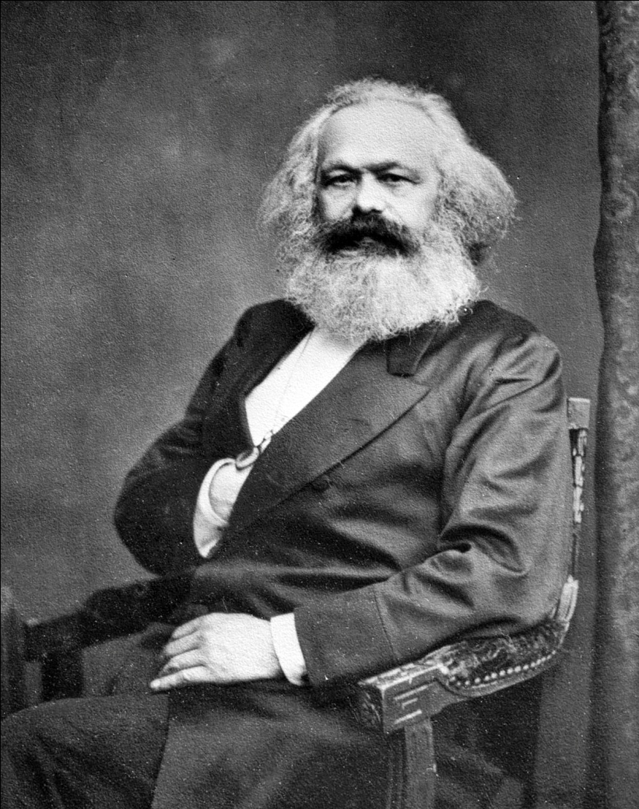
Marxist literary theory
Based on the theories of Karl Marx (and so influenced by philosopher Georg Wilhelm Friedrich Hegel), this school concerns itself with class differences, economic and otherwise, as well as the implications and complications of the capitalist system: "Marxism attempts to reveal the ways in which our socioeconomic system is the ultimate source of our experience" (Tyson 277).

Slide 16
Gender theory :
This type of criticism examines how sexual identity (gender) influences the creation and reception
of literary works.
Gender studies originated during the feminist movement, when critics began investigating assumptions
about gender in a piece of literature.
Feminist critics explored how an author’s gender might—consciously or unconsciously—affect his or her
writing.
These critics may also explore how images of men or women in literature might reflect or reject the social
norms around gender in a particular society.

Slide 17
Reader-response
This type of criticism attempts to describe what happens in the reader’s mind while
interpreting a text (reader’s reaction).
A reader-response critic might also explore the impact of a particular text on his or her own ideas or values.
For example, one might reflect on how a particular character seems admirable or unlikable and why.
One might reflect on how one’s religious, cultural, or social values affect readings.
It also overlaps with gender criticism in exploring how men and women may read the same text with
different assumptions.

Slide 18
The stylistic theory
It evaluates the manner of presentation in a work and focuses on the minor details like diction, vocabulary, tone and various style elements.

