Slide 1
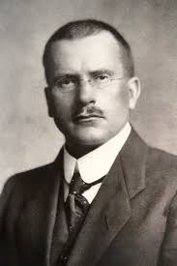
Carl Gustav Jung
The Jungian Theory
By Dr. N. BOUALLEGUE

Slide 2
Introduction
Swiss psychiatrist Carl Jung (1875-1961) was interested in the way in which symbols and common myths permeate our thinking on both conscious and subconscious levels. Jung initially worked with fellow psychoanalyst Sigmund Freud, whose 1899 work The Interpretation of Dreams had attached significance to the recurring themes and motifs in people's dreams, and sought to understand their relevance to subjects' psyches and their mental wellbeing. However, Jung and Freud later took different paths, with the former disagreeing with Freud's emphasis on the influence of biological factors such as libido on behavior and personality.

Slide 3
The Jungian Theory
Instead, Jung looked at areas of the mind that constitute the psyche, and the way in which they influenced one another. He distinguished the persona, or the image of ourselves that we present to the world, from our shadow, which may be comprised of hidden anxieties and repressed thoughts. Jung also noted the relationship between our personal unconscious, which contains an individual's personal memories and ideas, and a collective unconscious, a set of memories and ideas that is shared amongst all of humanity. Shared concepts, which Jung described as archetypes, permeate the collective unconscious and emerge as themes and characters in our dreams and surface in our culture - in myths, books, films and paintings, for example.

Slide 4
Personal Unconscious
Jung's idea of the personal unconscious is comparable to the unconsciousthat Freud and other psychoanalysts referred to. To Jung, it is personal, as opposed to the collective unconscious, which is shared amongst all persons.The personal unconscious contains memories which are unaware we still possess, often as a result of repression.As we exist in a conscious state, we do not have direct access to our personal unconscious, but it emerges in our dreams or in a hypnotic state of regression.

Slide 5
Collective Unconscious
The collective unconscious is key to Jung's theories of the mind as it contains the archetypes. Rather than being born as a tabula rasa (a 'blank slate' in Latin) and being influenced purely by our environment, as the English philosopher John Locke believed, Jung proposed that we are each born with a collective unconscious. This contains a set of shared memories and ideas, which we can all identify with, regardless of the culture that we were born into or the time period in which we live. We cannot communicate through the collective unconscious, but we recognise some of the same ideas innately, including archetypes.For example, many cultures have cultivated similar myths independently of one another, which feature similar characters and themes, such as the creation of the universe.

Slide 6
Archetypes
Jung noted that within the collective unconscious there exist a number of archetypes which we can all recognise. An archetype is the model image of a person or role and includes the mother figure, father, wise old man and clown/joker, amongst others. The mother figure, for example, has caring qualities; she is dependable and compassionate. We all hold similar ideas of the mother figure and we see her across cultures and in our language - such as the term 'mother nature'. Archetypes are often incarnated as characters in myths, novels and films - in the James Bond spy series, 'M' embodies the mother archetype, whom the spy trusts and returns to. Similar, archetypes permeate the cards of a Tarot deck: the mother archetype is seen in the qualities of the Empress card, whilst the Hermit embodies the wise old man archetype.

Slide 7
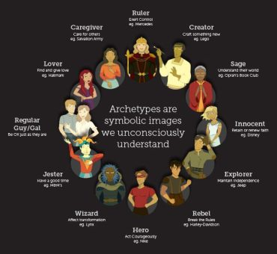

Slide 8
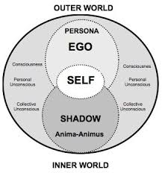

Slide 9
The Persona
Distinct from our inner self, Jung noted that we each have a persona - an identity which we wish to project to others. He used the Latin term, which can refer either to a person's personality the mask of an actor, intentionally, as the persona can be constructed from archetypes in the collective unconscious, or be influenced by ideas of social roles in society. For example, a father may adopt traits which he considers to be typical of a father - serious or disciplining, for example - rather than those which reflect his actual personality.Philip Zimbardo's study of social roles in a prison situation (1971) further demonstrated the effect that our role has on our persona. Assigned a role, such as that of a prison guard, people often behave as they would expect someone in their role to act. As the persona is not a true reflection of our consciousness, but rather an idealised image which people aspire to, identifying too much with a persona can lead to inner conflicts and a repression of our own individuality, which Jung claimed could be resolved through individuation.

Slide 10
The Shadow
The shadow archetype is composed primarily of the elements of ourselves that we consider to be negative. We do not show this side of the self to the outside world as it can be a source of anxiety or shame. The shadow may contain repressed ideas or thoughts which we do not wish to integrate into our outward persona, but these must be resolved in order to achieve individuation. However, it may also include positive traits, such as perceived weaknesses (for example, empathy) which may not fit into the 'toughness' that a person wants to present as a part of their persona.

Slide 11
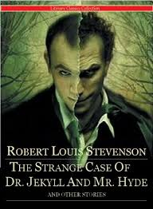
In literature, the shadow is often presented as a villainous character - for instance, as the snake in the Garden of Eden or The Jungle Book. Jung also observed Hyde, whom Dr. Jekyll transforms into, as representing the character's shadow in Robert Louis Stevenson's 1886 novella The Strange Case of Dr. Jekyll and Mr. Hyde.

Slide 12
Anima/Animus archetypes
The anima (in males) or animus (in females) represents the opposite gender to a person's self. As a person develops a gender identity, such as that of being male, they repress the aspects of their personality which might be considered to be feminine, such as empathy in social situations. Whilst these traits form part of the true, united self, they are held back from our persona and are represented in the form of the feminine archetype anima in males or the masculine archetype animus in females.The anima and animus are idealised impressions of the male or female, which emerge from the collective unconscious in dreams and inform our ideas of the opposite gender. As we age, they bring us into touch with the aspects of our personality repressed during the formation of a gender identity. For example, a man may allow their empathy to show more after the development of their masculine persona.The anima and animus can be found throughout our culture - Jane Austen's novel Pride and Prejudice, for example, presents the anima archetype as the idealised Mr Darcey.

Slide 13
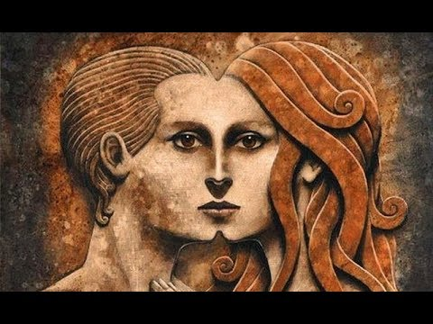

Slide 14
Individuation
Jung believed that by acquiring the qualities of an archetype from the collective unconscious, we repress those attributes of our true self which do not conform to the archetype. To achieve individuation and realise our true self, he claimed that, rather than repressing these traits, we must 'integrate' them by allowing them to surface from the shadow and to coexist with those in the ego, or true self. Analytical psychologists may encourage this integration, or individuation, through therapy including free association.

Slide 15
